Slide 1


Linux Fundamental
For DevOps
Stalin Thangapandian

Slide 2
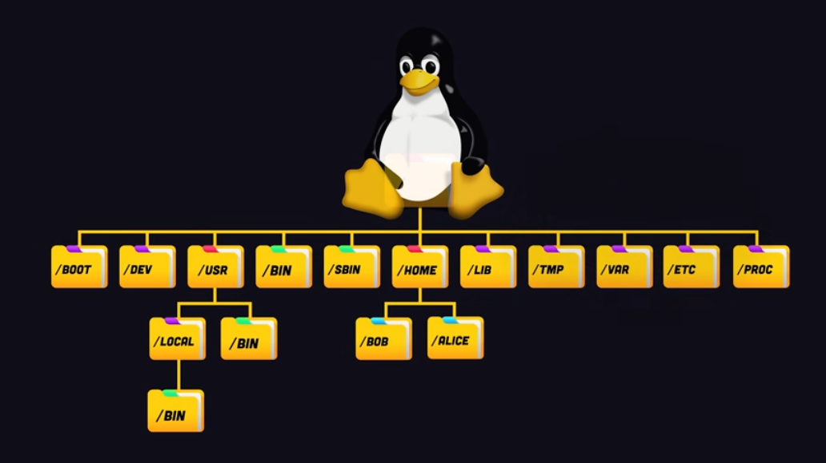
Linux filesystem hierarchy standard
Notes:
All fonts should be Calibri 9-28 only

Slide 3
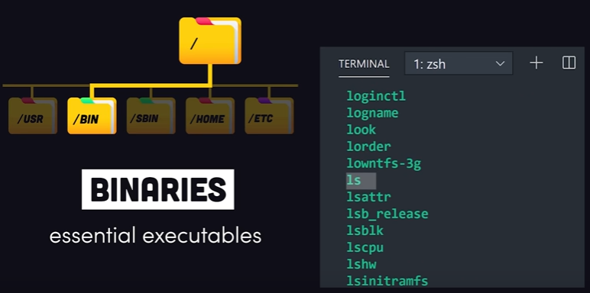
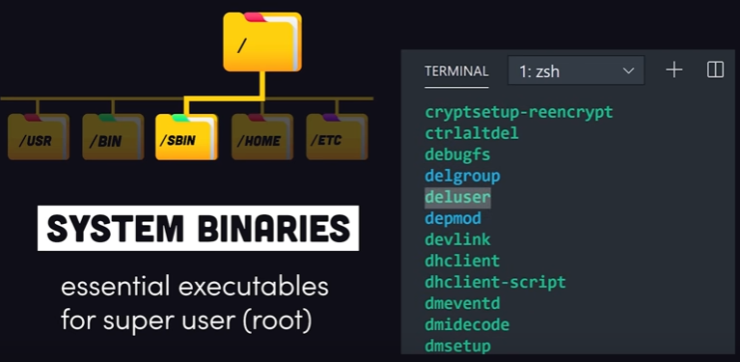
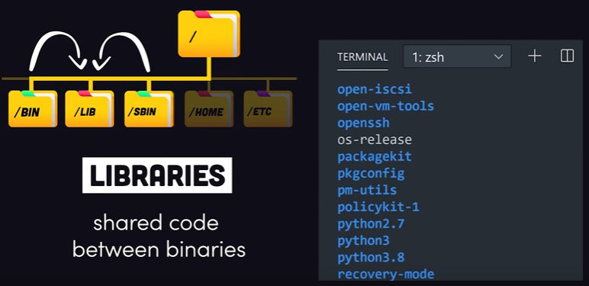
Linux File System ( /root - > /BIN, /SBIN and /LIB Folders )
Notes:
All fonts should be Calibri 9-28 only

Slide 4
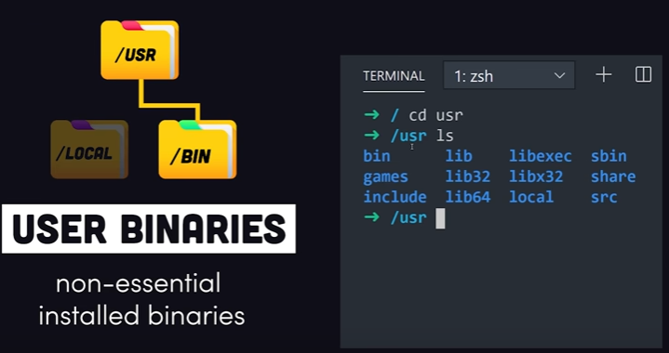
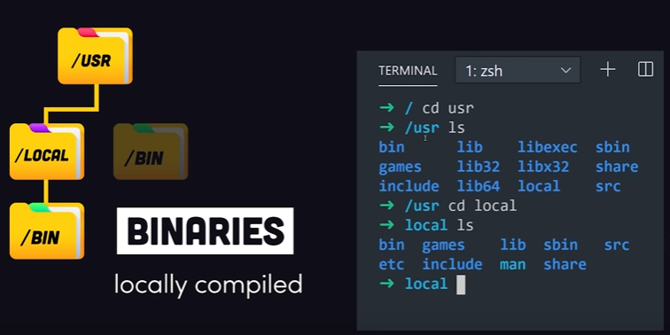
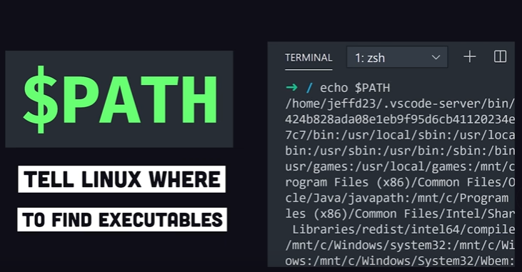
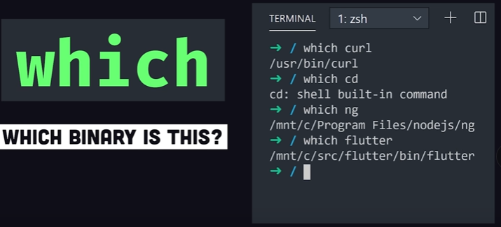
Linux File System ( /USR -> /BIN and /LOCAL Folders )
Notes:
All fonts should be Calibri 9-28 only

Slide 5
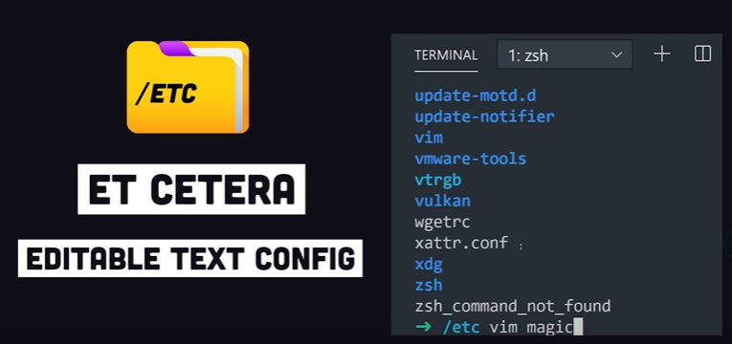
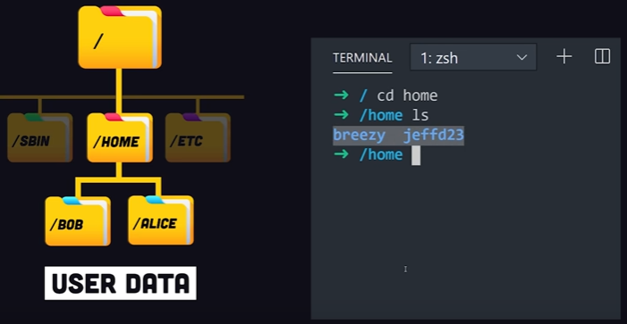
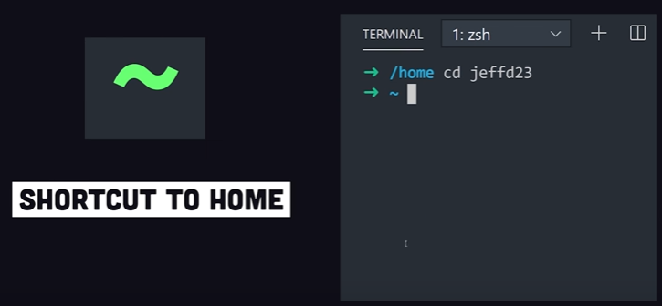
Linux File System (/root - > /ETC, /HOME)
Notes:
All fonts should be Calibri 9-28 only

Slide 6
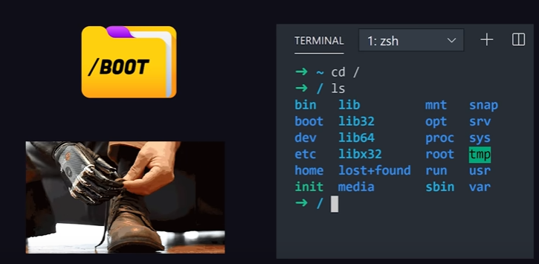
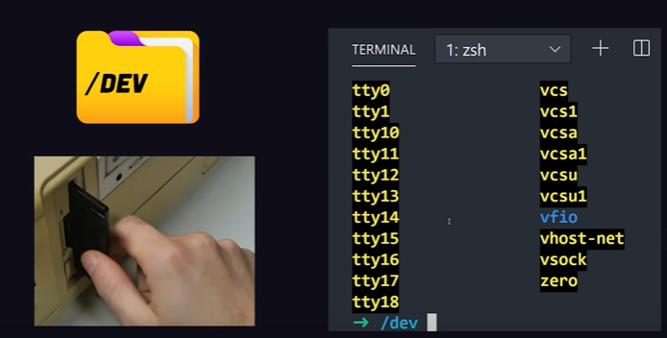
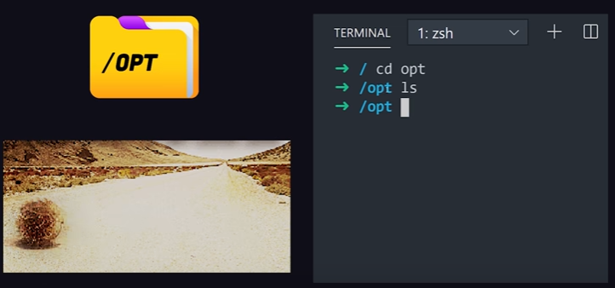
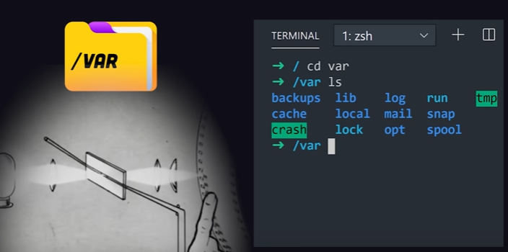
Linux File System (/root - > /BOOT, /DEV, /OPT, /VAR)
Notes:
All fonts should be Calibri 9-28 only

Slide 7
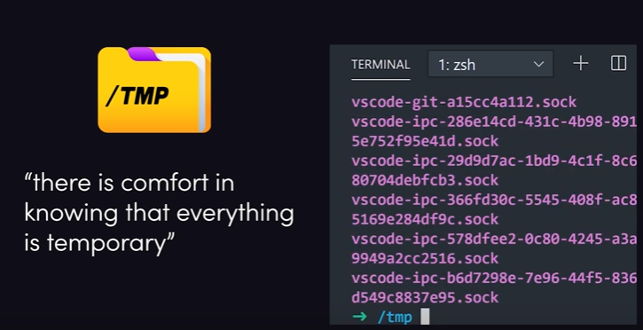
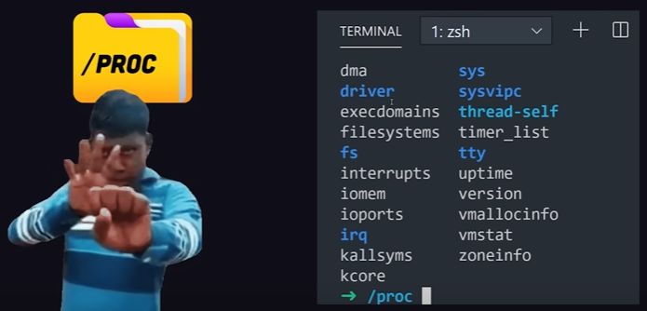
Linux File System (/root - > /TMP, /PROC)
Notes:
All fonts should be Calibri 9-28 only

Slide 8
Linux commands
man: It is used to display the user manual of any command that we can run on the terminal.
Syntax: man any command + enter
Example:
ls: It will list files and Directory's
Example1: list the files and directory's
Example2: list the files, directories and permissions.
clear: It is a standard Unix computer operating system command that is used to clear the terminal screen.
Syntax: clear + enter
Example:
pwd: stands for print working directory. It prints the path of the working directory, starting from the root.
Syntax: pwd + enter
Example:
$ man ls
$ man ls
$ man ls -l
$ clear
$ pwd
Notes:
All fonts should be Calibri 9-28 only

Slide 9
Linux commands
cd: stands for change directory. It is used to change the current working directory.
Syntax: cd /directory name + enter
Example:
echo: it is used to display line of text/string that are passed as an argument.
Syntax: echo string + enter
Example:
whoami: It displays the username of the current user
Syntax: whoami + enter
Example:
su: stands for substitute or switch user. It is used to switch to another user.
Syntax: su username + enter or even sudo bash can be used
Example:
$ cd /home
$ echo ”infinitians”
$ whoami
$ su
Notes:
All fonts should be Calibri 9-28 only

Slide 10
Linux commands
sudo bash: It is used to switch from any user to root user.
Syntax: sudo bash + enter
Example:
Note: Check with whoami cmd to see the change after executing sudo bash cmd.
useradd: It is used to add user in linux.
Syntax: sudo useradd user_name + enter
Example:
Setting password for user john:
Example:
Just follow-up with password and retype password to set password.
$ sudo bash
$ sudo useradd John
$ sudo passwd John
Notes:
All fonts should be Calibri 9-28 only

Slide 11
Linux commands
userdel: It is used to delete user.
Syntax: sudo userdel user_name + enter
Example:
groupadd: It is used to add a group.
Syntax: sudo groupadd group_name + enter
Example:
groupdel: It is used to delete a group.
Syntax: sudo groupdel group_name + enter
Example:
touch: It is used to create a file.
Syntax: sudo touch filename.extn + enter
Example:
$ sudo userdel John
$ sudo groupadd Techies
$ sudo groupdel Techies
$ sudo touch demo.txt
Notes:
All fonts should be Calibri 9-28 only

Slide 12
Linux commands
touch: continued..
Once file is created check the file by using ls cmd
We can edit that file by using vi editor
Example:
Now demo.txt will be opened in vi editor.
Press i to insert data
Press esc + :wq to save and exit
cat: stands for concatenate. It reads data from the file and gives their content as output. It helps us to create, view, concatenate files.
Syntax: cat filename.extn + enter
Example:
cp: stands for copy. It is used to copy files or group of files or directory. It creates an exact image of a file on a disk with different file name. It require at least two filenames in its arguments.
$ sudo vi demo.txt
$ cat demo.txt
Notes:
All fonts should be Calibri 9-28 only

Slide 13
Linux commands
cp: continued..
Syntax: cp filename.extn path + enter
Example:
Note: to see whether the file demo.txt copied to specified path please follow below steps.
goto the john directory by telling cd john\
now type pwd cmd to check your current working directory
now tell ls cmd to see the file demo.txt
mv: stands for move. It is used to move one or more files or directories from one place to another place.
Syntax: sudo mv flag filename path + enter
Example:
rm: stands for remove. It is used to remove objects such as files, directories, symbolic links
Syntax: sudo rm filename.extn + enter
Example:
$ cp demo.txt /home/John
$ sudo mv demo.txt /home
$ sudo rm demo.txt
Notes:
All fonts should be Calibri 9-28 only

Slide 14
Linux commands
mkdir: stands for make directory. It is used to create new directory.
Syntax: sudo mkdir path + enter
Example:
Note: use ls in terminal to see the created directory
rmdir: stands for remove directory. It is used to delete a directory.
Syntax: sudo rmdir directory name + enter
Example:
Note: use ls cmd to see the created directory
grep: It is used to search a word in a file
Syntax: grep word to be searched filename.extn
Example:
$ sudo mkdir /home/Techies
$ sudo rmdir Techies
$ grep cat greptest.txt
Notes:
All fonts should be Calibri 9-28 only

Slide 15
Linux commands
sort: It is used to sort words in file.
Syntax: sort filename.extn
Example:
chown: It is used to change the file Owner or group. Whenever you want to change ownership, you can use chown command.
3 types of permissions:
Read - This permission allows the user to read files and in directories, it lets the user read directories and subdirectories stores in it.
Write - This permission allows a user to modify and delete a file. Also, it allows a user to modify its contents (create, delete and rename files in it) for the directories. Unless the execute permission is not given to directories changes does do affect them.
Execute - The write permission on a file allows it to get executed. For example, if we have a file named php.sh so unless we don’t give it execute permission it won’t run.
$ sort sorttest.txt
$ ls -l
Notes:
All fonts should be Calibri 9-28 only

Slide 16
Linux commands
chown: Continued..
3 types of file permission:
user – It affect the owner of the file.
Group - affect the group which owns the file. Instead of the group permissions, the user permissions will apply if the owner user is in this group.
other - affect all other users on the system.
To see the permission, use the below cmd
Example:
Changing user:
Example:
Note: type ls –l to see the permission
$ ls -l
$ chown root demo.txt
Notes:
All fonts should be Calibri 9-28 only

Slide 17
Linux commands
chmode: stands for change mode. It is used to change the access mode of a file. “0”-no permission ,
“1”- Execute permission, “2”- Write permission, “4”- Read permission, “7”- Read, Write and Execute.
Example: type ls –l to see the permission
lsof: It is used to list out all opened files in the output console.
Example:
id: It is used to find out user, group names and numeric id’s of current user or any other user
Syntax: id flag username
Flags: -g → prints only effective group id’s
-G → prints all the group id’s
-n → prints names
-u → prints only effective user id’s
-help → displays help messages
-version → gives version information
Example 1:
Note: id without option displays every set of information.
Example 2: id – u john, id –g john, id john etc
$ chmod 777 demo.txt
$ lsof
$ id John
Notes:
All fonts should be Calibri 9-28 only

Slide 18
Linux commands
tar: It is used to zip and unzip files of .tar format. To zip folder:
$ tar -cf compressed.tar file1 file2 file3
- To Zip a File
$ tar -xf compressed.tar –C /home/mydirectory
- To UN-Zip a File to a Specific directory
$ tar –tf compressed.tar
- To list out the files inside the compressed directory
$ tar –xf compressed.tar directory
- To compress a list of files inside a directory instead of compressing by explicitly mentioning the files
Notes:
All fonts should be Calibri 9-28 only

Slide 19
Linux commands
Cut: cut command is used for extracting a portion of a file using columns and delimiters so say for example if you want to list everything in a selected column then in this case you need to use the -C flag with the cut command so say for example
Output:
a11
b22
c33
Output:
a1
b2
c3
$ cat demo1.txt
$ cut –c1-2 demo1.txt
$ cut –c1 demo1.txt
- To display single Column
Notes:
All fonts should be Calibri 9-28 only

Slide 20
Linux commands
sed: sed is a text editor which can perform editing operations in a non interactive way, so sed command gets its input from a standard input or a file to perform the editing operations on a file so sed is a very powerful utility and you can do a lot of file manipulations using sed, so say for example if you want to replace a text in a file by searching it in a file you can use the said command with the substitute s flag smallest to search for the specific pattern and change it, so say for Example…
Output:
How are u Stalin ?
Output:
How are u Lenin ?
$ cat sedtest.txt
$ sed ‘s/Stalin/Lenin/’ sedtest.txt
Notes:
All fonts should be Calibri 9-28 only

Slide 21
Linux commands
uniq: It is used to filter out duplicate lines in a file.
Example:
watch: It is used to execute a program periodically showing output in full screen. Screen will get updated every 2 seconds and will run until interrupted with ctrl + c.
Syntax: watch flag command
Example: watch –d free –m
$ uniq demo.txt
$ watch –d free -m
Notes:
All fonts should be Calibri 9-28 only

Slide 22
Linux commands
eval: It is a built-in linux command used to execute arguments as shell cmd.
Syntax: eval args
Example:
history: It is used to view previously used commands.
Syntax: history + enter
Example1:
Example2: history 10 (This will view 10 previously used cmds)
dd: It is a command-line utility used for convert and copy files.
Syntax: option = value
To copy data from one hdd to another hdd
Example:
Note: if means input-file and of means output-file
$ eval --help
$ history
$ history 10
$ dd if = /dev/had of = /dev/hdb
Notes:
All fonts should be Calibri 9-28 only

Slide 23
Linux commands
free: It displays the total amount of free space available along with the amount of memory used and swap memory in the system, and the buffers used by the kernel.
Syntax: free options + enter
Options:
-b → displays memory in bytes
-k → displays memory in kilo bytes
-m → displays memory in mega bytes
-g → displays memory in giga bytes
Example:
ssh: stands for secure shell. It is a protocol used to securely connect to a remote server/system.
Example1:
Example2:
ssh-keygen: this command is used to generate a public private keypair, so authentication keys allows a user to connect to a remote system without supplying the password, so keys must be generated for each user separately.
Example:
$ free -g
$ ssh master-ip
$ ssh slave-ip
$ ssh-keygen -t rsa
Notes:
All fonts should be Calibri 9-28 only

Slide 24
Linux commands
ip: It is used for performing several network administration tasks.
Example1: (this shows ip addresses associated on all network devices.)
Example2: ip link(this shows link layer information)
ifconfig: It is used to configure the kernel-resident network interfaces.
Syntax: ifconfig options interface
Example1: (this shows ip addresses associated on all network devices.)
Example2: ifconfig –a (This option is used to display all the interfaces available, even if they are down.)
Example3: ifconfig –s (Display a short list)
netstat: It displays various network related information such as network connections, routing tables, interface statistics, masquerade connections, multicast memberships etc.
Example1: (to show both listening and non-listening socket)
Example2: netstat –at (to list all tcp ports)
$ ip address
$ ifconfig
$ netstat -a
Notes:
All fonts should be Calibri 9-28 only

Slide 25
Linux commands
nslookup: stands for name server lookup. It is used for getting information from DNS server.
Example:
curl: It is used to transfer data to or from a server.
Example:
awk: It is a scripting language used for manipulating data and generating reports.
Example1::
Note: awk ‘{print}’ awktest.txt (prints all the lines of awktest.txt)
$ nslookup google.com
$ curl –o url
$ awk ‘/Stalin/ {print}’ awktest.txt
Notes:
All fonts should be Calibri 9-28 only

Slide 26
Linux commands
tr: It is used for translating or deleting characters.
To convert from lower to upper case characters in a file
Example:
env: It is used to print environment variables; it is also used to run a utility or and command in a custom environment.
Example: env + enter
Example: env –i command (to run a command with empty environment)
Example: env –u variable-name (to remove an variable from the environment)
iptables: It is used to set up and maintain tables for the Netfilter firewall for IPv4, included in the Linux kernel.
Example: (to stop iptables firewall service)
$ cat cba.txt | tr “[a-z]” “[A-Z]”
$ service iptables stop
Notes:
All fonts should be Calibri 9-28 only

Slide 27
Linux commands
apt-get: stands for advanced packaging tool. It is used to handle packages.
Example:
df: stands for disk free. It is used to display information related to file systems about total space and available space.
Example: sudo df –h (prints sizes in power of 1024 - human-readable)
du: stands for disk usage. It is used to estimate file space usage.
Example:
$ sudo apt-get install git
$ sudo df -h
$ sudo du /home/john
$ sudo du –h –d 1 /var/
Notes:
All fonts should be Calibri 9-28 only

Slide 28
Linux commands
Vi: The VI editor is the most popular and classic text editor in the Linux family.
Example:
:wq – Save and exit, :q- Quit, :qa! - abandon
Systemctl: is used to examine and control the state of “systemd” system and service manager.
Example:
Shutdown now: stands for disk usage. It is used to estimate file space usage.
Example1: is for shutdown you Linux systems
Example2: is for rebooting you Linux systems
$ sudo vi demo2.txt
$ systemctl start sshd
$ systemctl enable sshd
$ shutdown now
$ shutdown now -r
Notes:
All fonts should be Calibri 9-28 only

Slide 29
Linux commands
Shutdown now: stands for disk usage. It is used to estimate file space usage.
Example1: is for shutdown you Linux systems
Example2: is for rebooting you Linux systems
$ shutdown now
$ shutdown now -r
Notes:
All fonts should be Calibri 9-28 only

Slide 30


Slide 31
Annexure

Slide 32
Linux files to be created on Linux
Awstest.txt:
Content:
Hi This is John
demo1.txt:
Content:
A11
B22
C33
C33
sedtest.txt:
Content:
How are you John ?
Greptest.txt
Content:
Dog apple ball cat cat mouse
sorttest.txt:
Content:
mad
sad
dad
Bad
Tad
fad
Cba.txt:
Content:
Hi, this is John !
Notes:
All fonts should be Calibri 9-28 only

